Slide 1


<Sisam Khadka>
<2025-02-24>

Slide 2

Outline
Executive Summary
Introduction
Methodology
Results
Conclusion
Appendix

Slide 3
Executive Summary
Summary of Methodologies
Data Collection through API
Data Collection with Web Scraping
Data Wrangling
Exploratory Data Analysis (EDA) with SQL
Exploratory Data Analysis with Data Visualization
Interactive Visual Analytics with Folium
Machine Learning Prediction
Summary of Results
Exploratory Data Analysis Results
Interactive Analytics (Screenshots Included)
Predictive Analytics Results

Slide 4
Introduction
Project background and context
The SpaceX Falcon 9 First Stage Landing Prediction project focuses on predicting whether the Falcon 9 first stage will land successfully after a launch. SpaceX's ability to reuse the first stage significantly lowers launch costs, with each launch priced at $62 million compared to over $165 million by other providers. By predicting whether the first stage will land, the project helps estimate the cost of a launch, making it valuable for companies looking to compete with SpaceX. The goal is to create a machine learning model that can predict the success of the first stage landing, ultimately helping SpaceX maintain its cost advantage.
Problems you want to find answers
What hidden patterns and trends can be uncovered from the dataset through exploratory data analysis?
How accurately can a machine learning model predict outcomes based on the given data?
What geographical insights can be revealed using interactive maps and location-based analytics?

Slide 5

Section 1

Slide 6
Methodology
Executive Summary
Data collection methodology:
Describe how data was collected
Perform data wrangling
Describe how data was processed
Perform exploratory data analysis (EDA) using visualization and SQL
Perform interactive visual analytics using Folium and Plotly Dash
Perform predictive analysis using classification models
How to build, tune, evaluate classification models

Slide 7
Data Collection
API Data Collection: We made a GET request to the SpaceX API to collect Falcon 9 launch data, decoded it into JSON format, and converted it into a pandas DataFrame for analysis.
Data Cleaning: We checked for missing values in the collected data and filled in the missing information to ensure data consistency.
Web Scraping: We scraped Falcon 9 launch records from Wikipedia using BeautifulSoup, extracting the data from an HTML table and converting it into a pandas DataFrame.
Structured Data: The data collection process allowed us to gather and organize the data efficiently, ensuring it was ready for analysis.

Slide 8
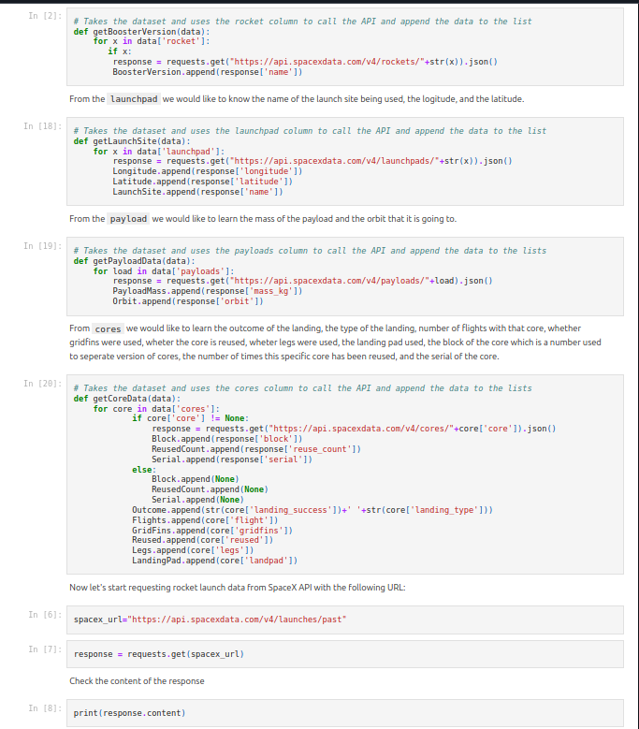
Data Collection – SpaceX API
To collect SpaceX launch data, we send a GET request to the API, parse the response into a DataFrame, and clean the data. We then enrich the data by making additional API calls for details like booster version, launchpad location, and payload mass. Finally, the enriched data is ready for analysis.
https://github.com/SisamK/Applied-Data-Science-Course/blob/main/jupyter-labs-spacex-data-collection-api.ipynb

Slide 9
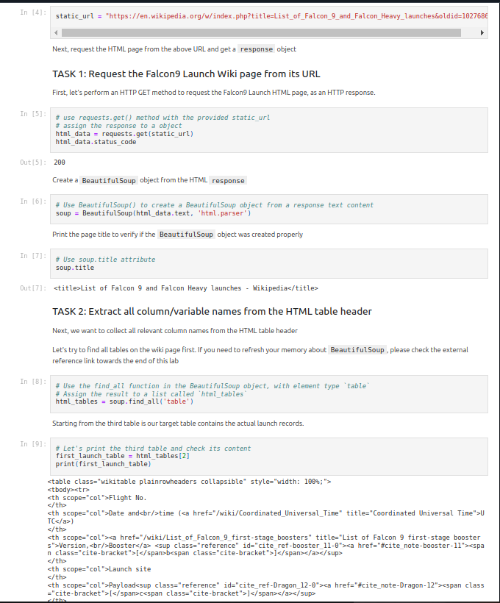
Data Collection - Scraping
To scrape Falcon 9 launch records, the process starts by importing necessary packages like requests, beautifulsoup4, and pandas. The first step is to fetch the webpage using requests.get(). Once the page is fetched, it’s parsed with BeautifulSoup to extract the relevant table headers. Then, a dictionary is created with keys derived from these headers. Next, the script loops through the table rows to extract data and populate the dictionary.
https://github.com/SisamK/Applied-Data-Science-Course/blob/main/jupyter-labs-webscraping.ipynb

Slide 10
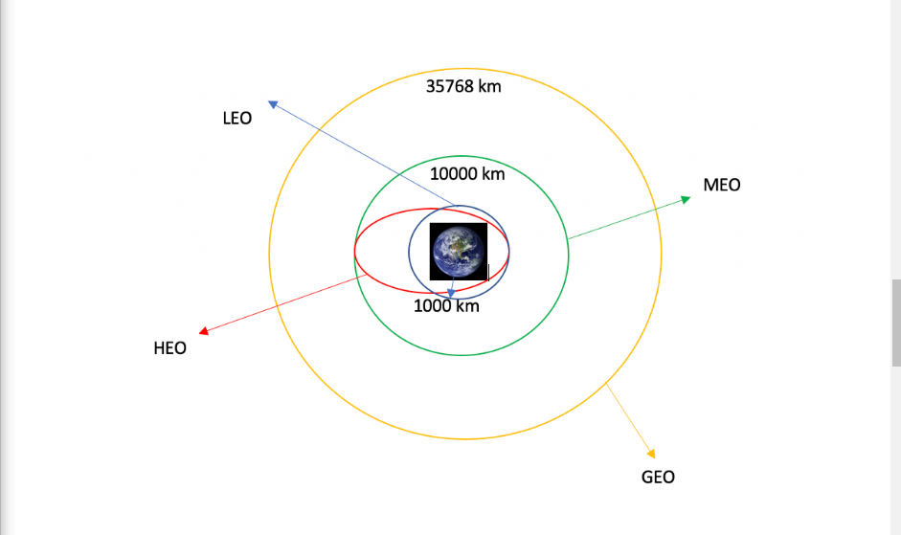
Data Wrangling
The data were processed by loading a CSV file containing SpaceX launch details. Exploratory Data Analysis (EDA) was performed to identify missing values and categorize numerical and categorical columns. Missing values in the "LandingPad" column were identified, and the number of launches by site, orbit type distribution, and mission outcomes were analyzed using value counts to understand the dataset better.
https://github.com/SisamK/Applied-Data-Science-Course/blob/main/labs-jupyter-spacex-Data%20wrangling.ipynb

Slide 11
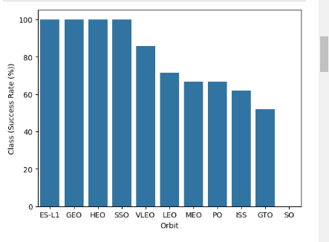
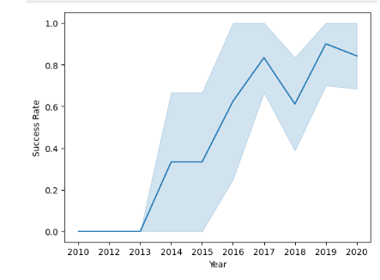
EDA with Data Visualization
The analysis visualizes Falcon 9 first-stage landing success using scatter, bar, and line plots. Findings reveal improved success with experience, varied performance across launch sites and orbit types, and heavier payloads landing reliably in LEO, ISS, and Polar orbits. Over time, SpaceX’s success rate has increased, highlighting advancements in technology and operational efficiency.
https://github.com/SisamK/Applied-Data-Science-Course/blob/main/edadataviz.ipynb

Slide 12
EDA with SQL
Unique launch sites: SELECT DISTINCT LAUNCH_SITE FROM SPACEXTBL;
Launch sites starting with 'CCA' (5 records): SELECT LAUNCH_SITE FROM SPACEXTBL WHERE LAUNCH_SITE LIKE 'CCA%' LIMIT 5;
Total payload mass by NASA (CRS): SELECT SUM(PAYLOAD_MASS__KG_) FROM SPACEXTBL;
Average payload mass by F9 v1.1: SELECT AVG(PAYLOAD_MASS__KG_) FROM SPACEXTBL;
First successful landing date on ground pad: SELECT MIN(DATE) FROM SPACEXTBL;
Boosters with successful drone ship landings & payload mass between 4000 and 6000: SELECT BOOSTER_VERSION FROM SPACEXTBL WHERE LANDING_OUTCOME = 'Success (drone ship)' AND PAYLOAD_MASS__KG_ BETWEEN 4000 AND 6000;
Top 5 boosters with highest payload mass: SELECT BOOSTER_VERSION, PAYLOAD_MASS__KG_ FROM SPACEXTBL ORDER BY PAYLOAD_MASS__KG_ DESC LIMIT 5;
Boosters with failed drone ship landings: SELECT BOOSTER_VERSION FROM SPACEXTBL WHERE LANDING_OUTCOME = 'Failure (drone ship)';
Launch sites and launch counts: SELECT LAUNCH_SITE, COUNT(*) FROM SPACEXTBL GROUP BY LAUNCH_SITE;
All launches with payload mass, mission, and outcome: SELECT DATE, PAYLOAD_MASS__KG_, MISSION_NAME, LANDING_OUTCOME FROM SPACEXTBL;
https://github.com/SisamK/Applied-Data-Science-Course/blob/main/jupyter-labs-eda-sql-coursera_sqllite%20(2).ipynb

Slide 13
Build an Interactive Map with Folium
In the Folium map, I added:
Folium Map – Initializes the map, centered on NASA Johnson Space Center.
Circular Markers – Highlight launch sites with labels for easy identification.
Text Labels – Display site names without clicking markers.
Marker Clusters – Reduce clutter by grouping launch markers.
Success/Failure Markers – Green for success, red for failure.
Color Function – Dynamically assigns marker colors based on launch outcomes.
https://github.com/SisamK/Applied-Data-Science-Course/blob/main/lab_jupyter_launch_site_location.ipynb

Slide 14
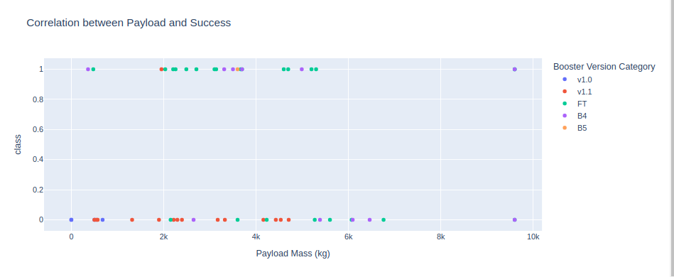
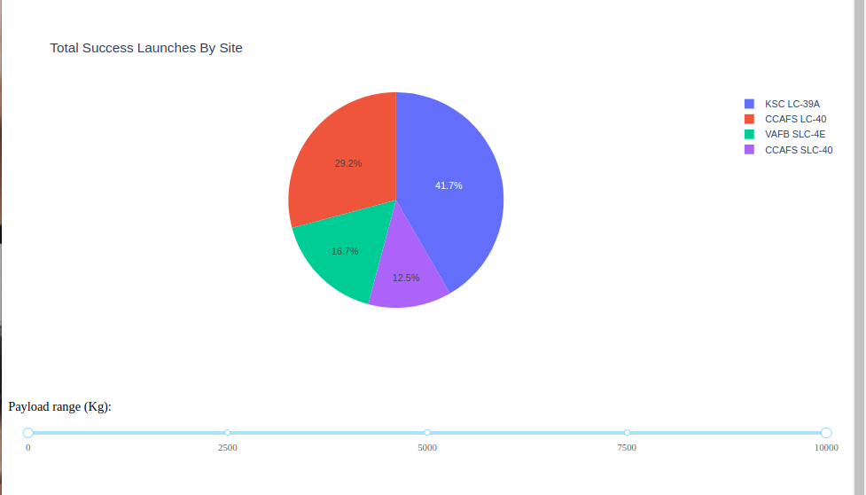
Build a Dashboard with Plotly Dash
The dashboard includes a Launch Site Dropdown to filter data by specific launch sites or view all sites together. A Success Pie Chart visualizes the success and failure rates for the selected site, offering a quick overview of launch success. The Payload Range Slider allows users to select a payload mass range and analyze its impact on launch success. A Success vs. Payload Scatter Plot displays the relationship between payload size and mission success, with color-coding for different booster versions. These components together enable interactive exploration of SpaceX launch data to uncover insights about success rates, payloads, and boosters.
https://github.com/SisamK/Applied-Data-Science-Course/blob/main/spacex_dash_app.py.1

Slide 15
Predictive Analysis (Classification)
To build the classification model, I started by preprocessing the dataset, including handling any missing values, and then standardized the features for consistent scaling. I split the data into training and testing sets to evaluate model performance on unseen data. I experimented with multiple classification algorithms, including Logistic Regression, Support Vector Machines, Decision Trees, and K-Nearest Neighbors, and performed a grid search to optimize their hyperparameters. After evaluating each model using accuracy and the confusion matrix, I determined the best-performing model based on its ability to predict successful Falcon 9 landings.
https://github.com/SisamK/Applied-Data-Science-Course/blob/main/SpaceX_Machine%20Learning%20Prediction_Part_5.ipynb

Slide 16
Results
Exploratory data analysis results
Interactive analytics demo in screenshots
Predictive analysis results

Slide 17

Section 2

Slide 18
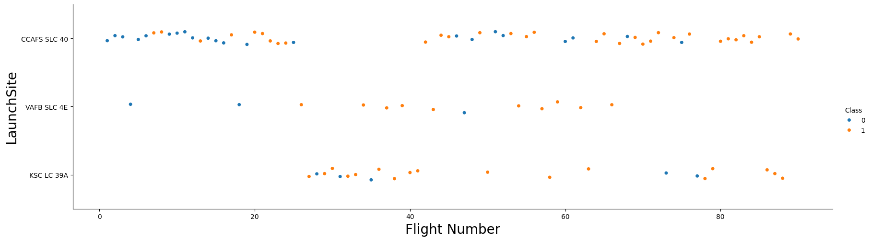
Flight Number vs. Launch Site
From the plot, we found that the larger the flight amount at a launch site, the
greater the success rate at a launch site.

Slide 19
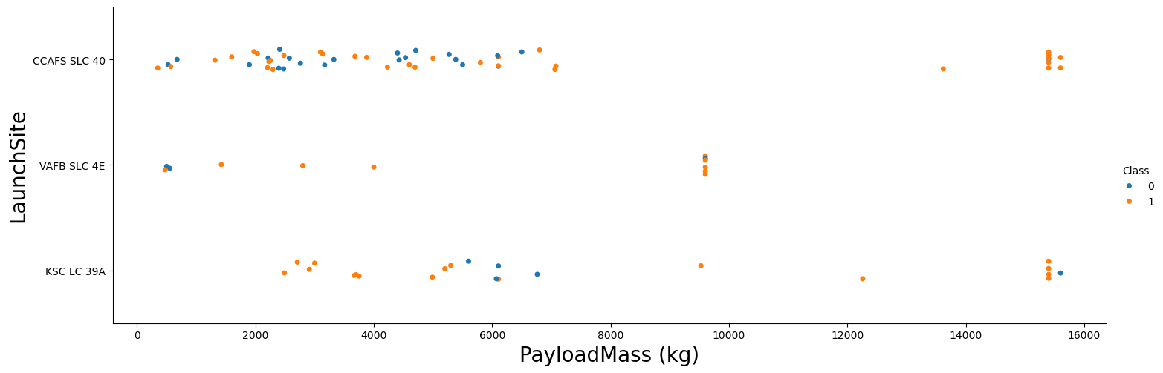
Payload vs. Launch Site
The scatter plot reveals that no rockets with payload masses greater than 10,000 kg were launched from the VAFB-SLC launch site.

Slide 20
Success Rate vs. Orbit Type
From the plot, we can see
that ES-L1, GEO, HEO, SSO,
VLEO had the most success
rate.

Slide 21
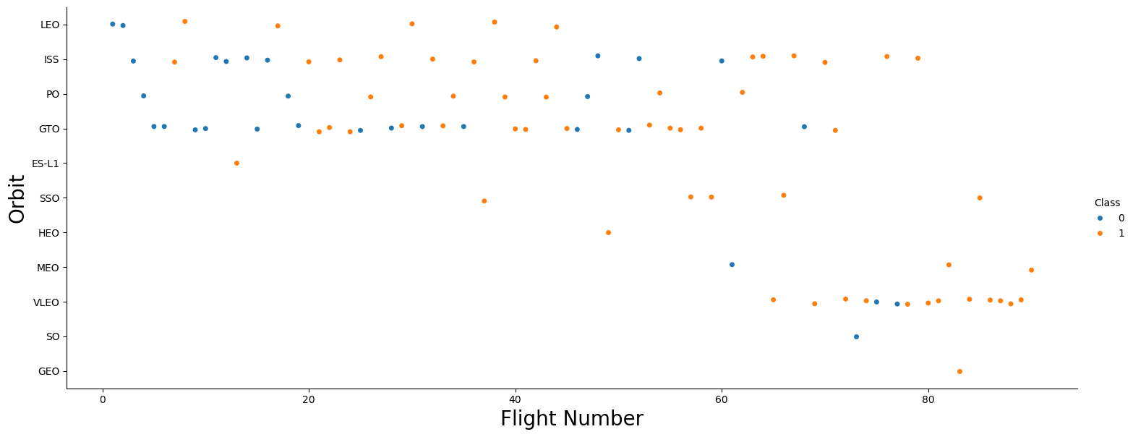
Flight Number vs. Orbit Type
The plot shows that for LEO orbit, the success rate increases with the number of flights, while for GTO orbit, there is no clear connection between the flight number and success.

Slide 22
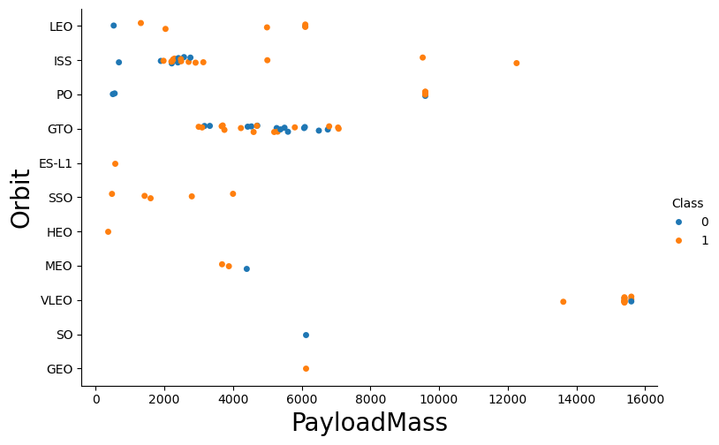
Payload vs. Orbit Type
We can see that heavier payloads tend to have more successful landings for PO, LEO, and ISS orbits.

Slide 23
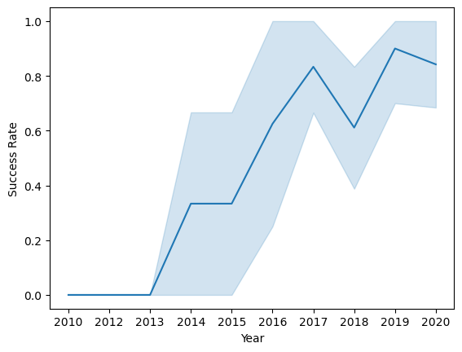
Launch Success Yearly Trend
From the plot, we can observe that success rate since 2013 kept on increasing till 2020.

Slide 24
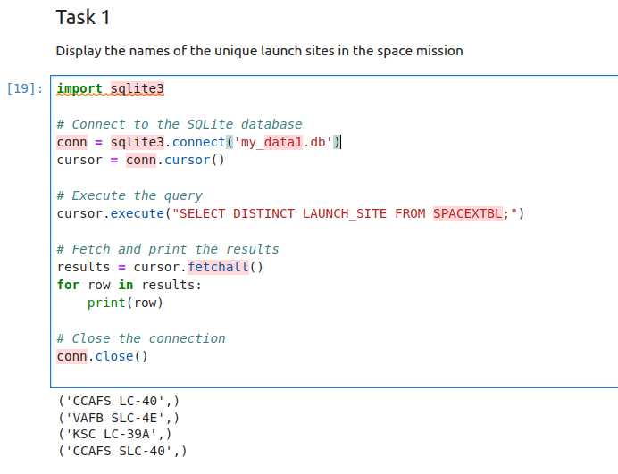
All Launch Site Names
I executed a SQL query to find the unique launch sites from the SPACEXTBL table in the database. The query used SELECT DISTINCT to ensure that only distinct (non-duplicate) launch sites are returned.

Slide 25
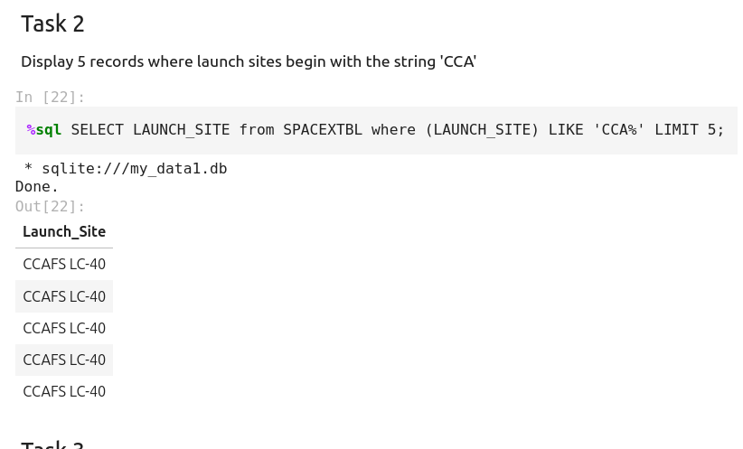
Launch Site Names Begin with 'CCA'
I used the query [ %sql SELECT LAUNCH_SITE from SPACEXTBL where (LAUNCH_SITE) LIKE 'CCA%' LIMIT 5;]to display 5 records where launch sites begin with `CCA

Slide 26
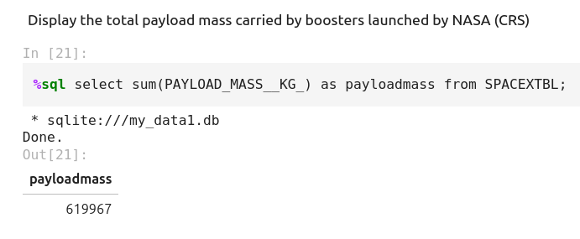
Total Payload Mass
We calculated the total payload carried by boosters from NASA as 619967 using the query below:
%sql select sum(PAYLOAD_MASS__KG_) as payloadmass from SPACEXTBL;

Slide 27
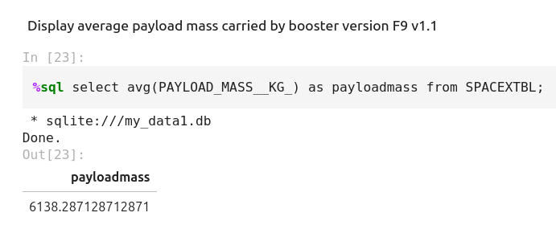
Average Payload Mass by F9 v1.1
We calculated the average payload mass carried by booster version F9 v1.1 as 6138.29

Slide 28
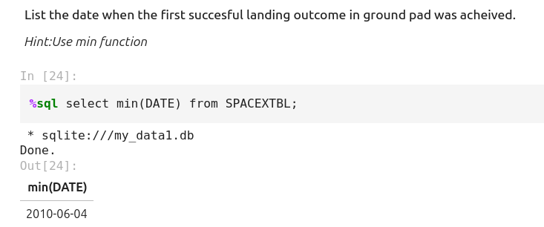
First Successful Ground Landing Date
The date was 2010-06-04

Slide 29
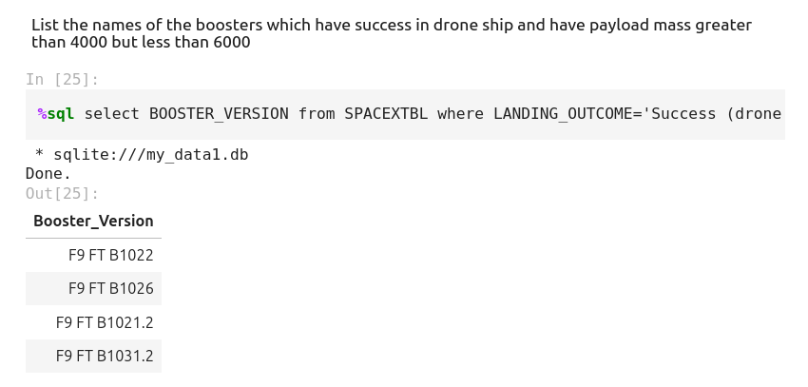
Successful Drone Ship Landing with Payload between 4000 and 6000
F9 FT B1022
F9 FT B1026
F9 FT B1021.2
F9 FT B1031.2

Slide 30
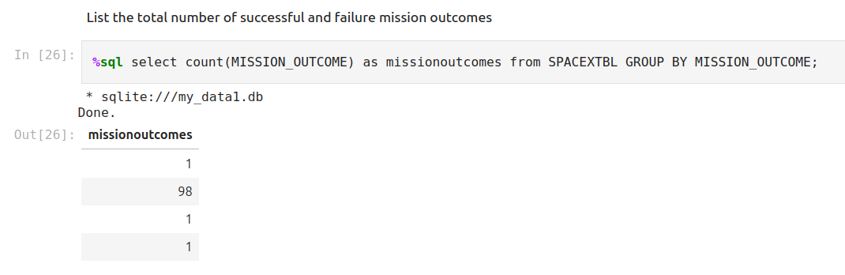
Total Number of Successful and Failure Mission Outcomes
This query is used to list the total number of successful and failed mission outcomes from the SPACEXTBL table.

Slide 31
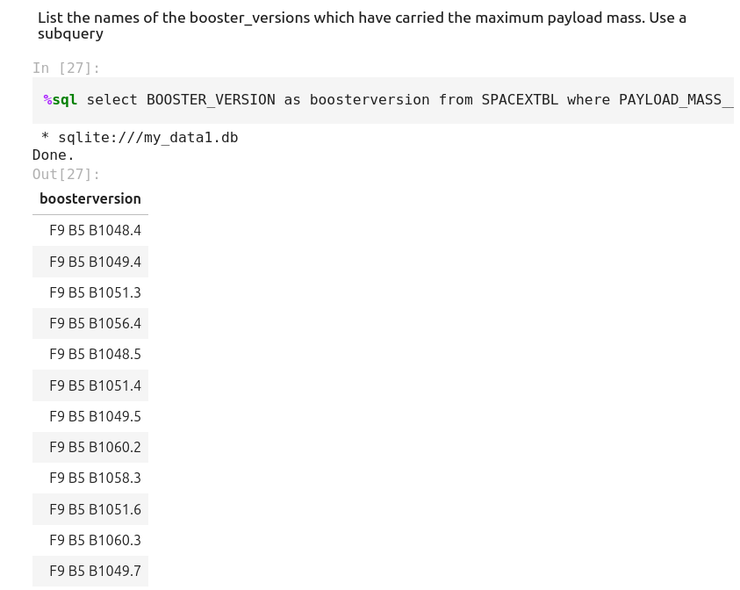
Boosters Carried Maximum Payload
We determined the booster that have carried the maximum payload using a subquery in the WHERE clause and the MAX() function.

Slide 32
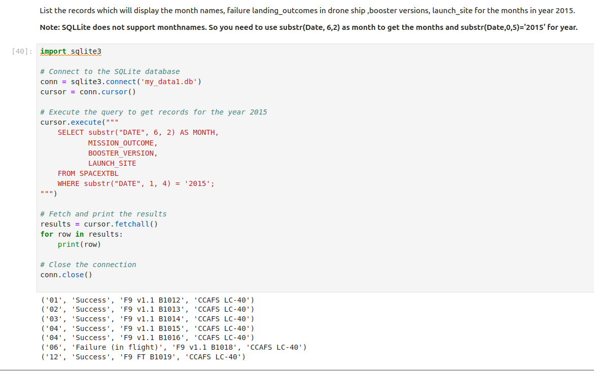
2015 Launch Records
The query extracts and displays information about missions that occurred in the year 2015, including the month of the mission, its outcome, the version of the booster used, and the site where it was launched.

Slide 33
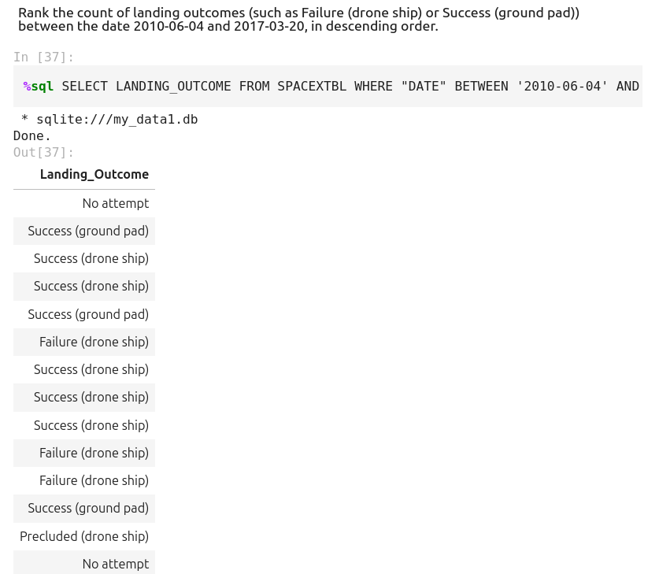
Rank Landing Outcomes Between 2010-06-04 and 2017-03-20
The query filters the records in the SPACEXTBL table to include only those within the date range from June 4, 2010, to March 20, 2017. It retrieves the LANDING_OUTCOME values for those records and orders them by the DATE in descending order. The results show various landing outcomes, including "Success (ground pad)", "Success (drone ship)", "Failure (drone ship)", and others, reflecting the different landing attempts and their respective outcomes during this period.

Slide 34

Section 3

Slide 35

Analysis of Launch Site Locations and Proximity to the Equator and Coastline

Slide 36

Visualization of Launch Site Success Rates on the Map

Slide 37
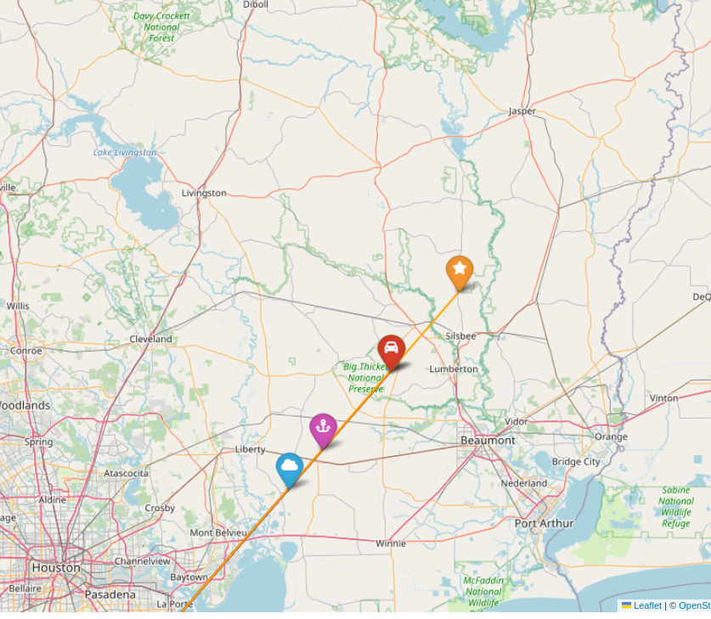
Distance from the launch site to each POI
I’ve assigned fun FontAwesome icons (cloud, road, car, anchor, star) to each point of interest for better visualization.

Slide 38

Section 4

Slide 39
PieChart

Slide 40
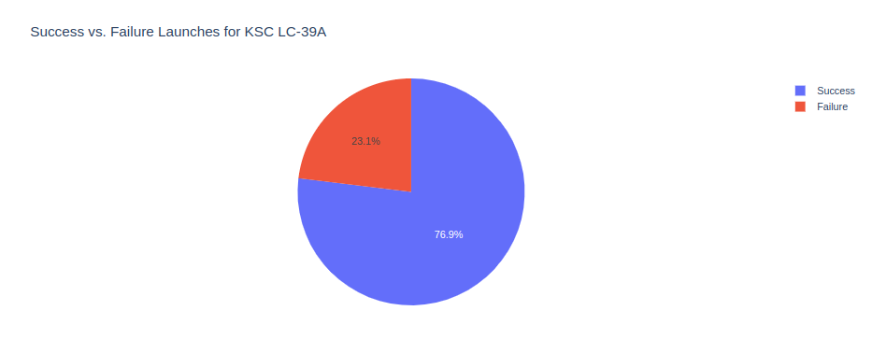
Pie chart showing the Launch site with the highest launch success ratio
KSC LC-39A had highest success rate with 76.9%

Slide 41
Scatter plot of Payload vs Launch Outcome for all sites, with different payload selected in the range slider

Slide 42

Section 5

Slide 43
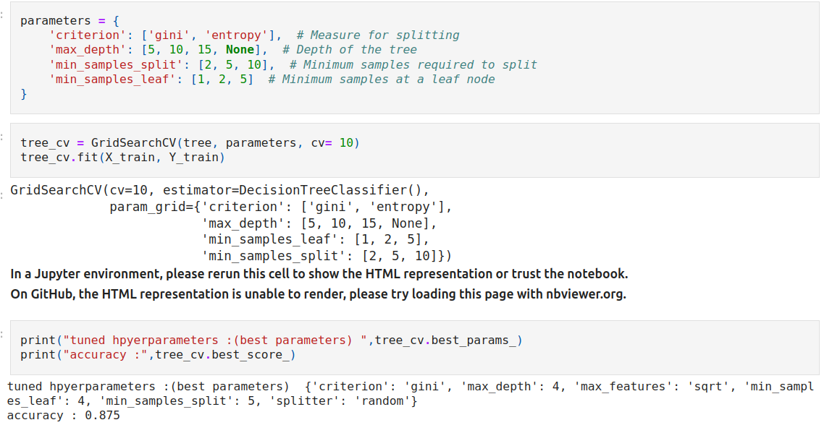
Classification Accuracy
The decision tree classifier is the model with the highest classification accuracy with 0.875 accuracy.

Slide 44

Confusion Matrix
The confusion matrix for the decision tree classifier indicates that the model is able to differentiate between the various classes. However, the primary issue lies in the false positives, where unsuccessful landings are incorrectly classified as successful landings.

Slide 45
Conclusions
More flights at a launch site lead to higher success rates.
The launch success rate improved from 2013 to 2020.
Orbits ES-L1, GEO, HEO, SSO, and VLEO had the highest success rates.
KSC LC-39A had the most successful launches.
The Decision Tree classifier is the best algorithm for this task.

Slide 46
FInal Say:
In this project I tried to complete all the tasks as it is but while drawing the dashboard I tried to add my own understanding to it. Here is the link to my source code: https://github.com/SisamK/Applied-Data-Science-Course/blob/main/spacex_dash_app.py.1

Slide 47


